Slide 1

UNIVERSITY SUCCESS ANALYSIS
UNIVERSITY SUCCESS ANALYSIS
Author: Viraj Narendra Bhutada
Author: Keshava Reddy

Slide 2
OVERVIEW
This project explores how various ranking systems impact university positions. We're using tools like SQL and Excel to crunch the data and understand the influence of different criteria. To make it all accessible, we're building a straightforward Power BI dashboard for a quick and easy look at university rankings. It's like a backstage pass to see how universities stack up – making the whole ranking game more down-to-earth and easy to follow.

Slide 3
OBJECTIVE
The goals of this project are to assess and compare university rankings, pinpoint the crucial factors shaping these rankings, and analyze regional trends. Through these objectives, we aim to provide a deeper understanding of the dynamics behind university positions in various ranking systems.

Slide 4
SIGNIFICANCE
This project holds substantial significance in enhancing our comprehension of university performance and the analysis of diverse ranking systems. Seeking to offer valuable insights into the factors influencing the success of universities, contributes to the ongoing efforts to understand and improve the higher education landscape.

Slide 5
DATA DICTIONARY
Dataset Description:
This dataset provides information on university rankings from various systems, including ranking criteria and university-specific data.
Table Explanations:
1. country:
- Description: A list of countries included in the dataset.
- Note: While not exhaustive, it encompasses a representative set of countries for the scope of this dataset.
2. university:
- Description: A list of universities ranked within the specified systems.
- Note: Each university is associated with a specific country.

Slide 6
3. ranking system:
Description: This table outlines the three distinct ranking systems used: Times Higher Education World University Ranking, Shanghai Ranking, and Center for World University Rankings.
4. ranking criteria:
Description: This table details the various criteria employed by each ranking system, such as Citations and Quality of Education.
Note: It also includes criteria contributing to the Total Score for each respective system.

Slide 7
5. university year:
- Description: Contains values for measurements such as the number of students and the student-to-staff ratio for each university over several years.
6. university ranking year:
- Description: This table includes the score for each year for each university, along with ranking criteria.

Slide 8
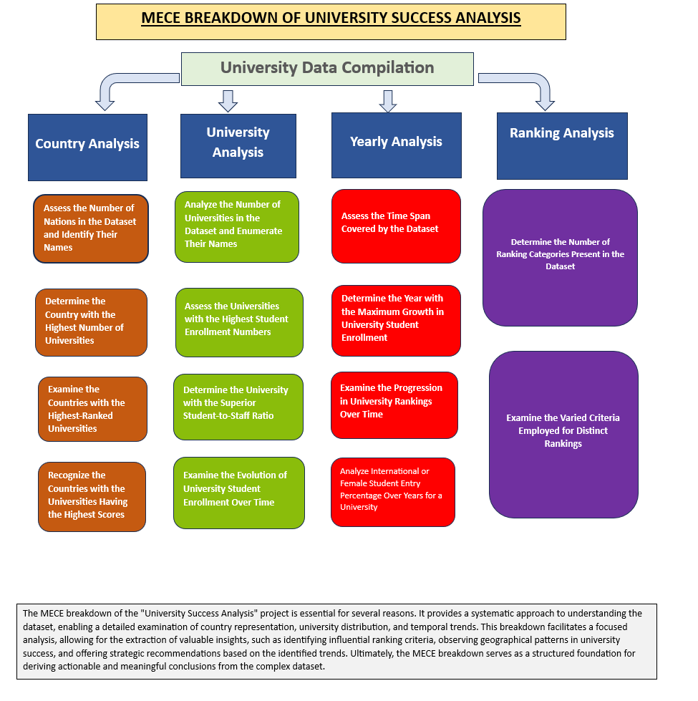

Slide 9
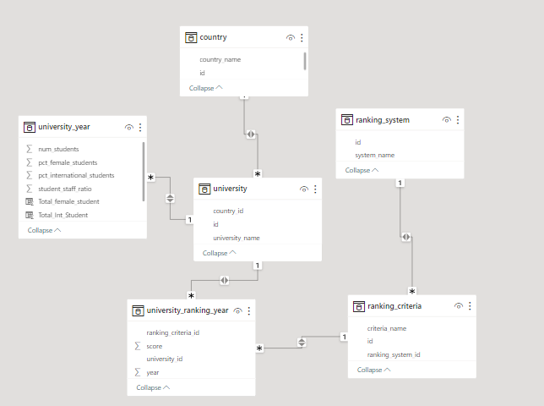
ER DIAGRAM

Slide 10
Exploratory Data Analysis (EDA) Journey: Unveiling University Success - Navigating Excel and SQL through 15 Insightful Questions

Slide 11
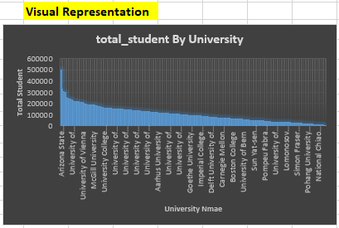
EDA
Problem Statement 1:- Is there a correlation between a country's GDP and the number of universities?
There Is No Relevant Data Of GDP In the Dataset Which Is Required In This Statement
New Problem Statement:- Evaluate Which University Has the Highest Number Of Students.
Arizona State University emerges as a standout, boasting the highest student population in the dataset. This underscores its notable enrollment, setting it apart from other universities in terms of student numbers.
INSIGHT

Slide 12
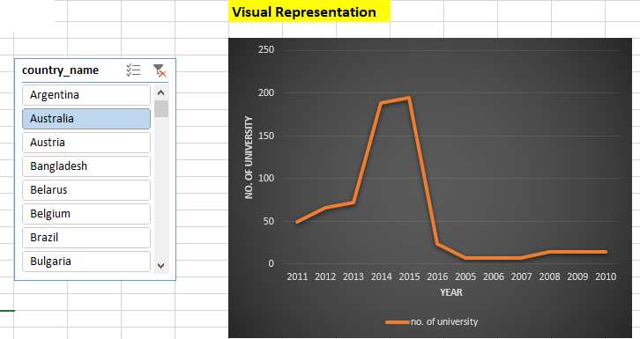
Problem Statement 2 :- How has the number of universities changed over the years in each country?
This insight sheds light on dynamic trends, showcasing fluctuating university numbers over time. It suggests diverse trajectories in different countries, indicating the ever-changing landscape of higher education.
INSIGHT

Slide 13
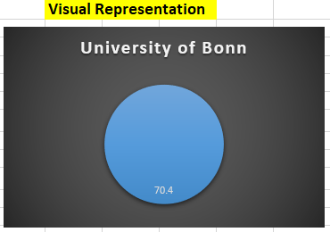
Problem Statement 3:- Is there a relationship between a country's population and the number of universities?
There Is No Relevant Data Of Population In the Dataset Which Is Required In This Statement
New Problem Statement:- Evaluate Which University Has Better Student-staff Ratio?
The University of Bonn demonstrates a notably favorable student-to-staff ratio compared to its peers. This observation suggests the potential for higher levels of individualized support and conducive learning environments, contributing to a positive educational experience.
INSIGHT

Slide 14
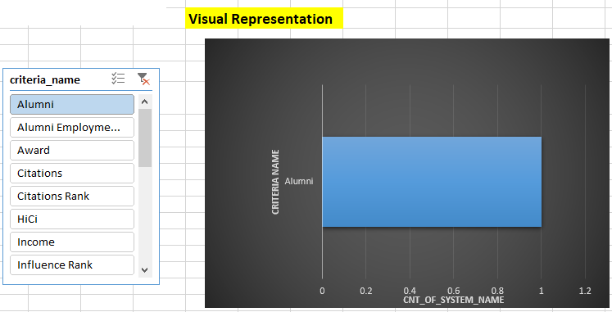
Problem Statement 4:- Are there any common criteria used by different ranking systems?
Ranking systems utilize distinct criteria, underscoring the emphasis on diversity in the assessment of universities.
INSIGHT

Slide 15
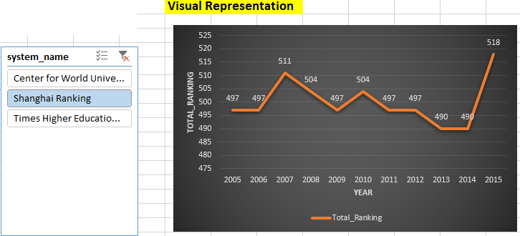
Problem Statement 5 :- What is the trend in university rankings over the years according to each system?
University rankings showcase dynamic patterns with significant variations over the years, uncovering volatility in assessments. Notably, the Central World Ranking demonstrates a sustained upward trajectory, suggesting the effectiveness of its evaluation criteria.
INSIGHT

Slide 16
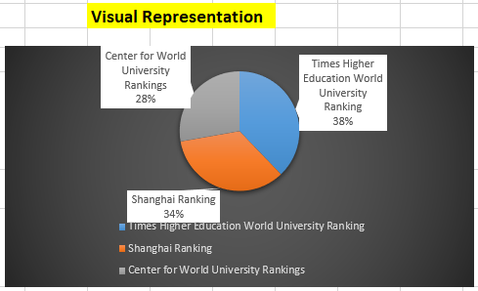
Problem Statement 6 :- How does the choice of ranking system affect a university's international student enrollment?
The Times Higher University Ranking notably draws a higher number of international students compared to other systems. This underscores its substantial influence in comparison to other ranking systems.
INSIGHT

Slide 17
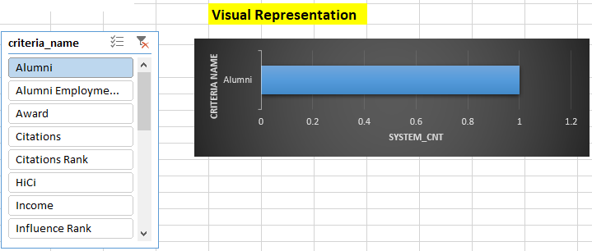
Problem Statement 7 :- Are there any criteria that have different weights in different ranking systems?
Diverse ranking systems employ unique criteria, highlighting varied weightage in each system. This underscores the diversity in the influence of criteria on rankings across different systems.
INSIGHT

Slide 18
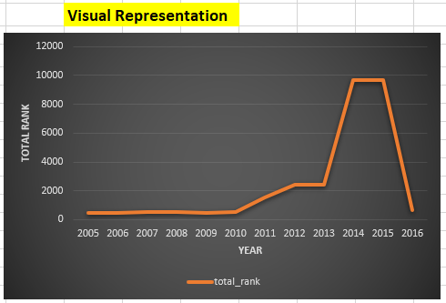
Problem Statement 8 :- How have the weights of ranking criteria changed over time?
University rankings typically demonstrate an ascending pattern, with a noteworthy decline observed in 2016.
INSIGHT

Slide 19
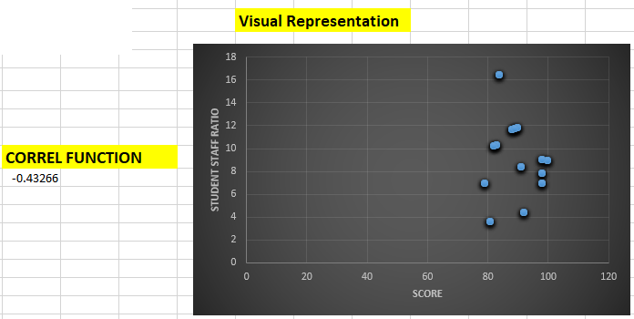
Problem Statement 9 :- Is there a relationship between a university's score and the student-staff ratio?
The scatter plot reveals a distinct negative correlation between university scores and student-staff ratio.
INSIGHT

Slide 20
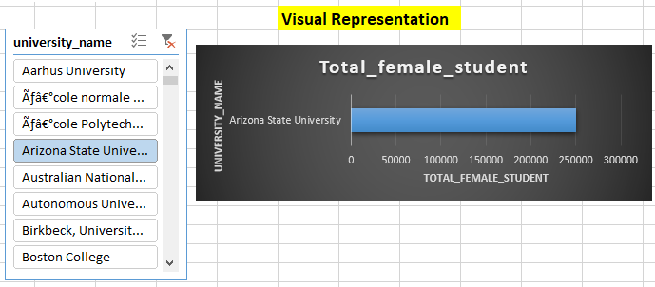
Problem Statement 10 :- How does the number of female students differ among universities?
Arizona State University takes pride in having the highest number of female students, while others notably have fewer in comparison.
INSIGHT

Slide 21
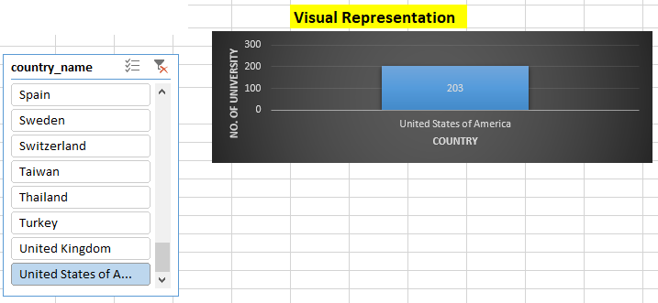
Problem Statement 11 :- What is the distribution of universities across different countries?
Based on the analysis, it's apparent that the United States possesses a greater quantity of universities than other nations.
INSIGHT

Slide 22
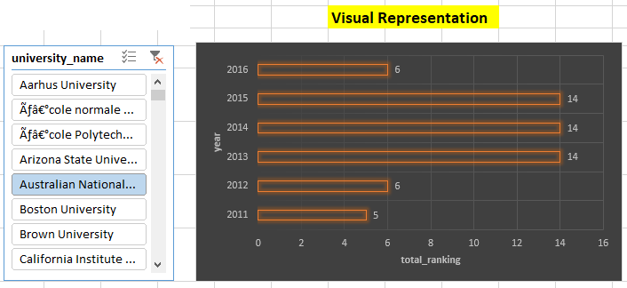
Problem Statement 12 :- How has the ranking of universities changed over the years?
Throughout the examination, it becomes evident that university rankings showcase variability rather than a steadfast and uniform progression in either direction.
INSIGHT

Slide 23
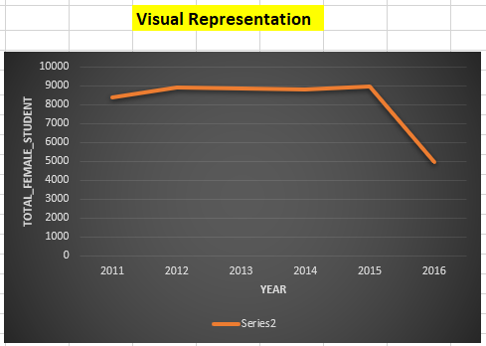
Problem Statement 13 :- What is the trend in the percentage of female students over time?
The examination indicates an initial upward trajectory succeeded by an abrupt decline in the year 2016.
INSIGHT

Slide 24
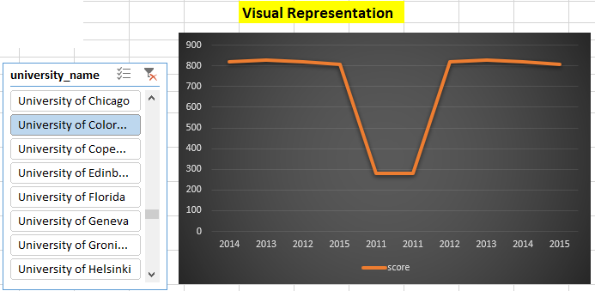
Problem Statement 14 :- How has the ranking score of universities evolved over the years?
The chart indicates fluctuating university scores over the years, suggesting a dynamic landscape in the academic performance of institutions.
INSIGHT

Slide 25
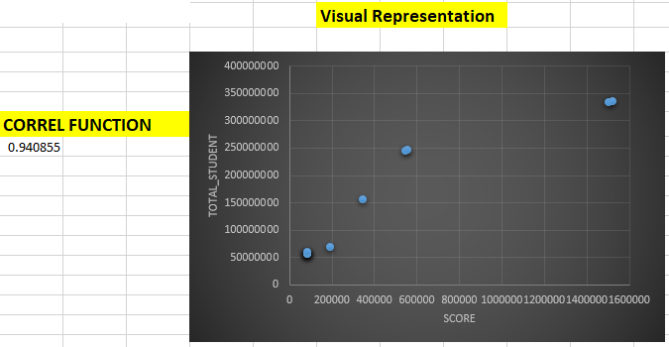
Problem Statement 15 :- Is there a relationship between a university's ranking score and the number of students over time?
The scatter plot reveals a distinct positive correlation between university scores and the number of students.
INSIGHT

Slide 26
Advanced Analytics: Power BI Interrogation - Examining University Success with 19 Key Questions Post EDA Exploration

Slide 27
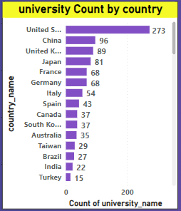
POWER BI
Problem Statement 1 :- How many universities are there in each country?
Upon analysis, it becomes evident that most universities are in the United States. However, it is important to note that the distribution of universities varies across different countries.
INSIGHT

Slide 28
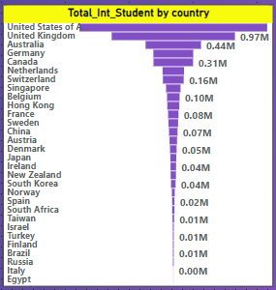
Problem Statement 2 :- What is the distribution of international students across different countries?
Analysis reveals the USA as a prominent destination for international students, with diverse student preferences observed across various countries.
INSIGHT

Slide 29
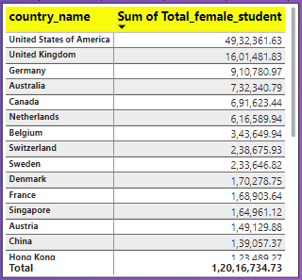
Problem Statement 3 :- Which country has the highest number of female students enrolled in universities?
Analysis indicates that the United States boasts the highest enrollment of female students in universities.
INSIGHT

Slide 30
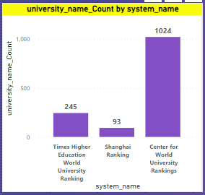
Problem Statement 4 :- How many universities are ranked by each ranking system?
This analysis reveals that a significant number of universities, approximately 1024, are ranked by the Center for World University Rankings. Additionally, 245 universities are ranked by the Times Higher Education ranking, and 93 universities are ranked by the Shanghai Ranking.
INSIGHT

Slide 31
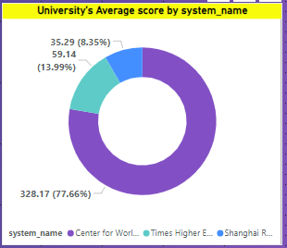
Problem Statement 5 :- What is the average score for universities according to each ranking system?
In this analysis, the Center for World University Rankings system consistently achieves the highest scores, while the Shanghai ranking system tends to attain comparatively lower average scores.
INSIGHT

Slide 32
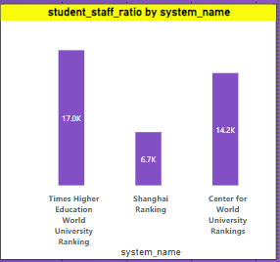
Problem Statement 6 :- How does the ranking system affect a university's student-staff ratio?
This analysis suggests that among the various ranking systems, Times Higher Education ranking has a more pronounced impact on the student-to-staff ratio.
INSIGHT

Slide 33
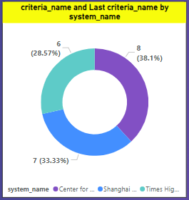
Problem Statement 7 :- What are the most important criteria considered by ranking systems?
This analysis reveals that the Center for World University Rankings favors the "Total CWUR" criteria, while the Shanghai Ranking system prefers the "Total Shanghai" criteria. Meanwhile, the Times Higher Education World Ranking leans towards the "Total Times" criteria.
INSIGHT

Slide 34
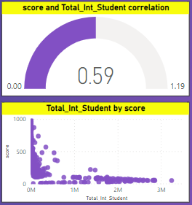
Problem Statement 8 :- Is there a correlation between a university's score and the number of international students?
The scatter and gauge analysis unmistakably indicates a strong positive correlation between a university's score and the number of international students.
INSIGHT

Slide 35
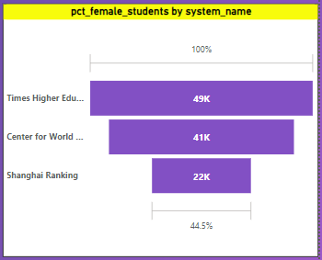
Problem Statement 9 :- How does the percentage of female students impact a university's ranking?
This analysis suggests a notable trend: a higher preference among female students for universities ranked by Times Higher Education. This preference not only impacts that specific ranking but also influences other ranking systems.
INSIGHT

Slide 36
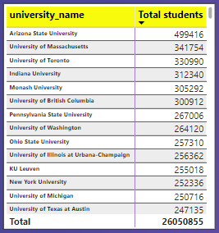
Problem Statement 10 :- Which university has the highest number of students?
The analysis reveals that Arizona State University has the highest number of students enrolled, making it the university with the maximum student population.
INSIGHT

Slide 37
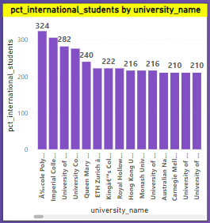
Problem Statement 11 :- How does the percentage of international students vary across different universities?
The analysis indicates that Polytechnic Lausanne University is highly preferred by international students, as it boasts the highest number of international students among the options.
INSIGHT

Slide 38
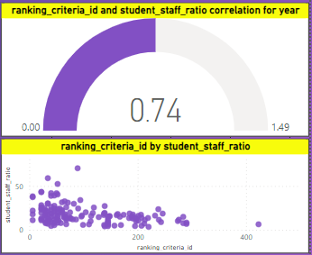
Problem Statement 12 :- Is there a correlation between a university's ranking and its student-staff ratio?
The scatter and gauge analysis clearly reveals a strong positive correlation between a university's ranking and its student-staff ratio.
INSIGHT

Slide 39
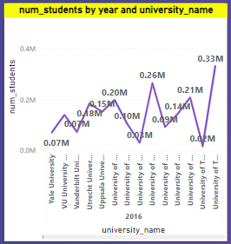
Problem Statement 13 :- How does the number of students in universities change over time?
This analysis suggests that the number of students in universities is fluctuating, whereas Arizona University consistently maintains the same student population.
INSIGHT

Slide 40
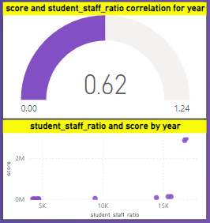
Problem Statement 14 :- Is there a correlation between a university's ranking score and the student-staff ratio over the years?
In examining the scatter and gauge data, a robust positive correlation emerges between the university score and the student-staff ratio.
INSIGHT

Slide 41
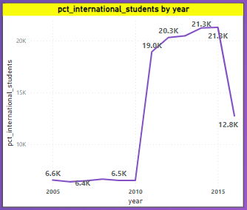
Problem Statement 15 :- How does the percentage of international students vary across different years?
This analysis reveals a consistent increase in the number of international students in universities from 2005 to 2015, followed by a sudden drop in 2016.
INSIGHT

Slide 42
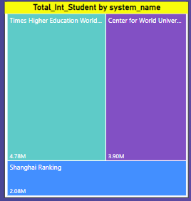
Problem Statement 16 :- What is the impact of a university's ranking on the number of international students it attracts?
This analysis suggests a preference among international students for universities ranked higher in the Times Higher Education ranking compared to other ranking systems.
INSIGHT

Slide 43
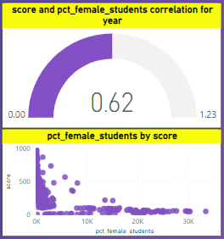
Problem Statement 17 :- Is there a relationship between a university's ranking score and the percentage of female students enrolled?
In the scatter and gauge analysis, a clear and strong positive relationship is observed between university scores and the percentage of female students.
INSIGHT

Slide 44
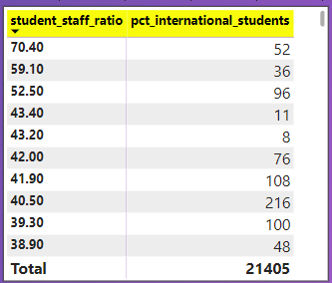
Problem Statement 18 :- How does the percentage of international students affect a university's student-staff ratio?
The analysis indicates that the percentage of international students does not notably impact the university's student-to-staff ratio.
INSIGHT

Slide 45
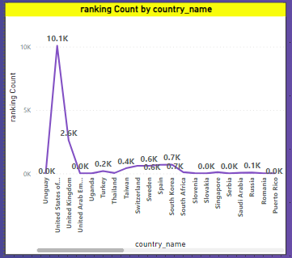
Problem Statement 19 :- Are there any significant trends or patterns in the rankings of universities from different countries?
This analysis highlights that the USA has the highest number of ranked universities compared to other countries. Furthermore, there is no discernible trend in university rankings as they fluctuate across different countries.
INSIGHT

Slide 46
PUBLICATIONS

Slide 47
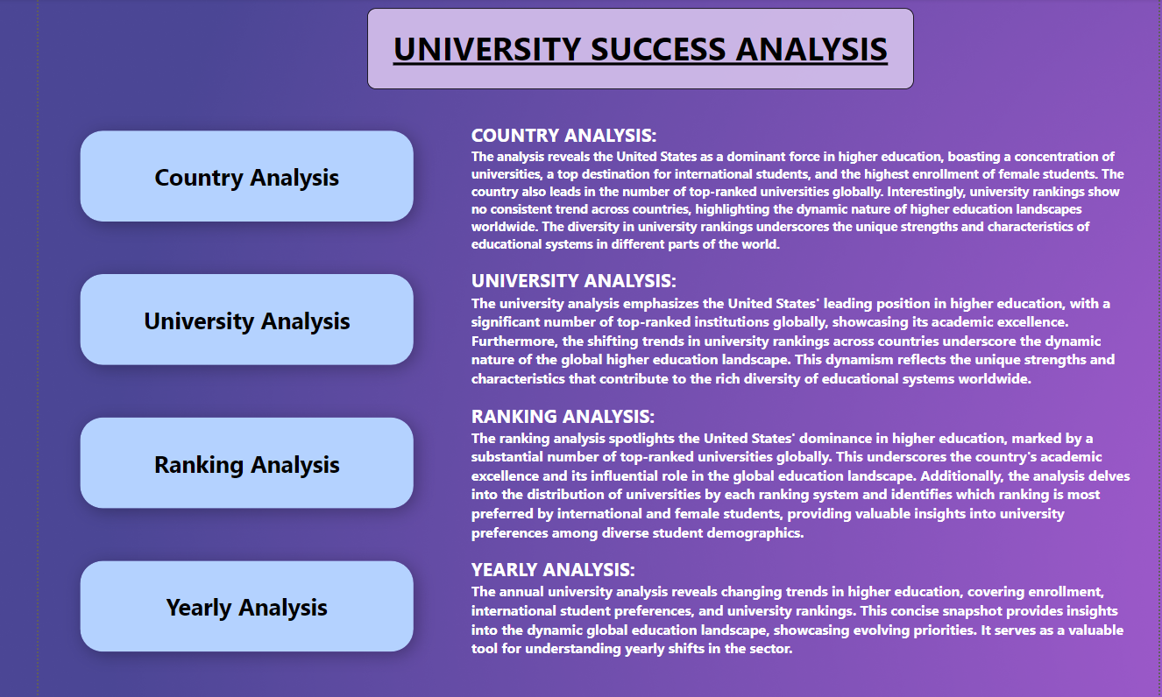

Slide 48
POWER BI DASHBOARDS

Slide 49
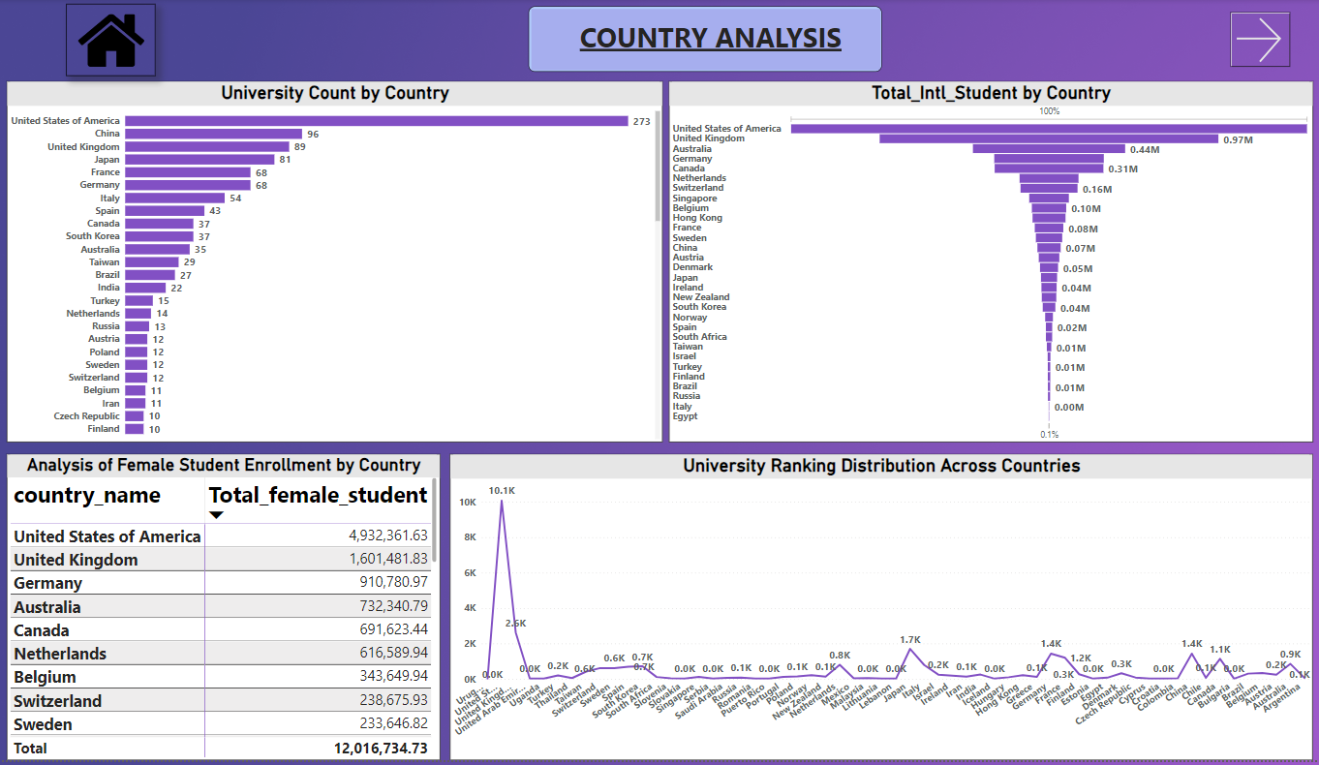

Slide 50
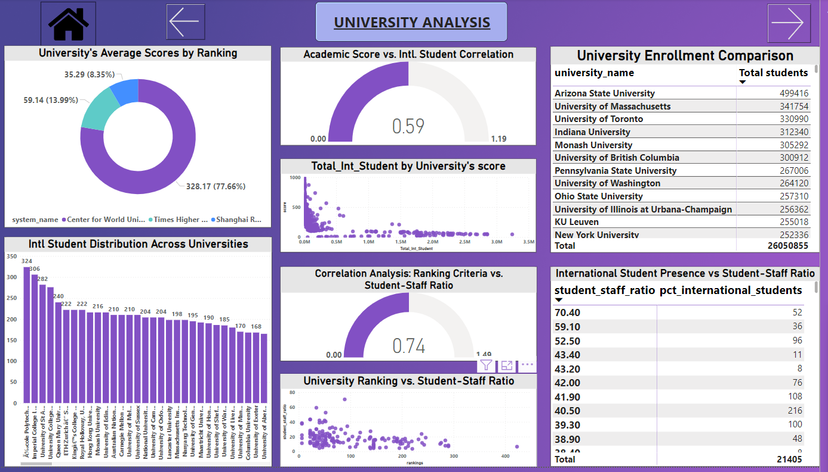

Slide 51
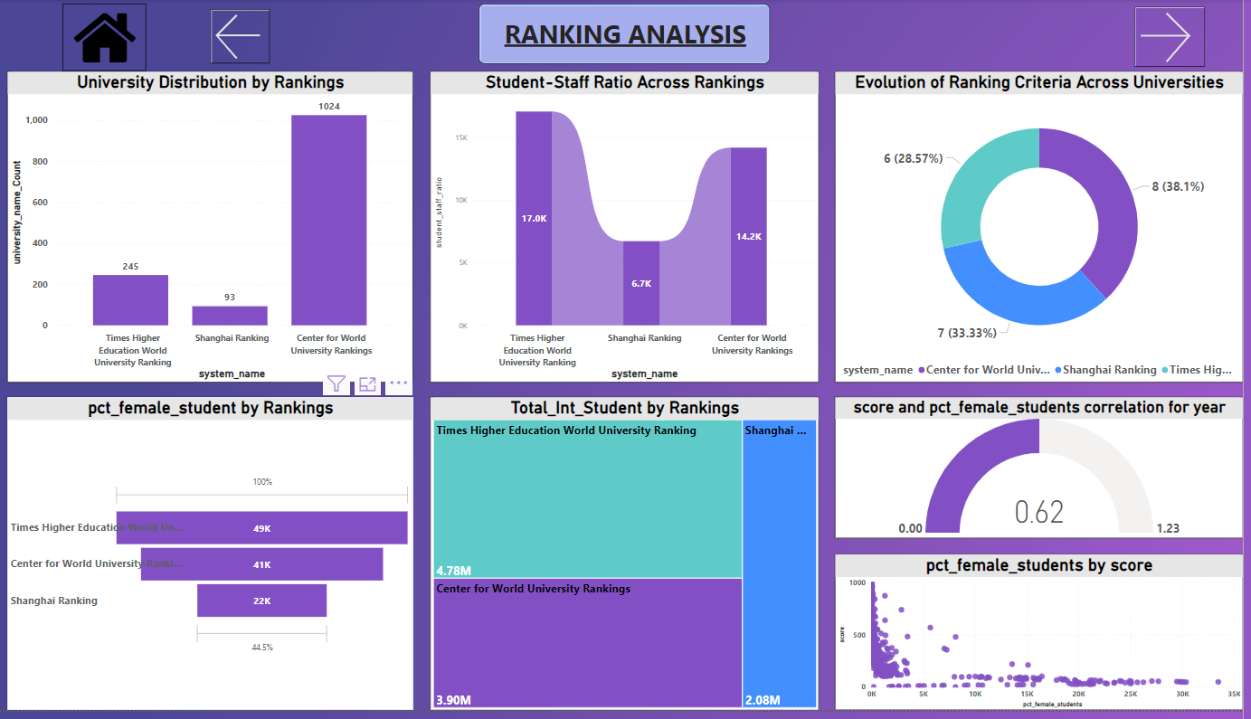

Slide 52
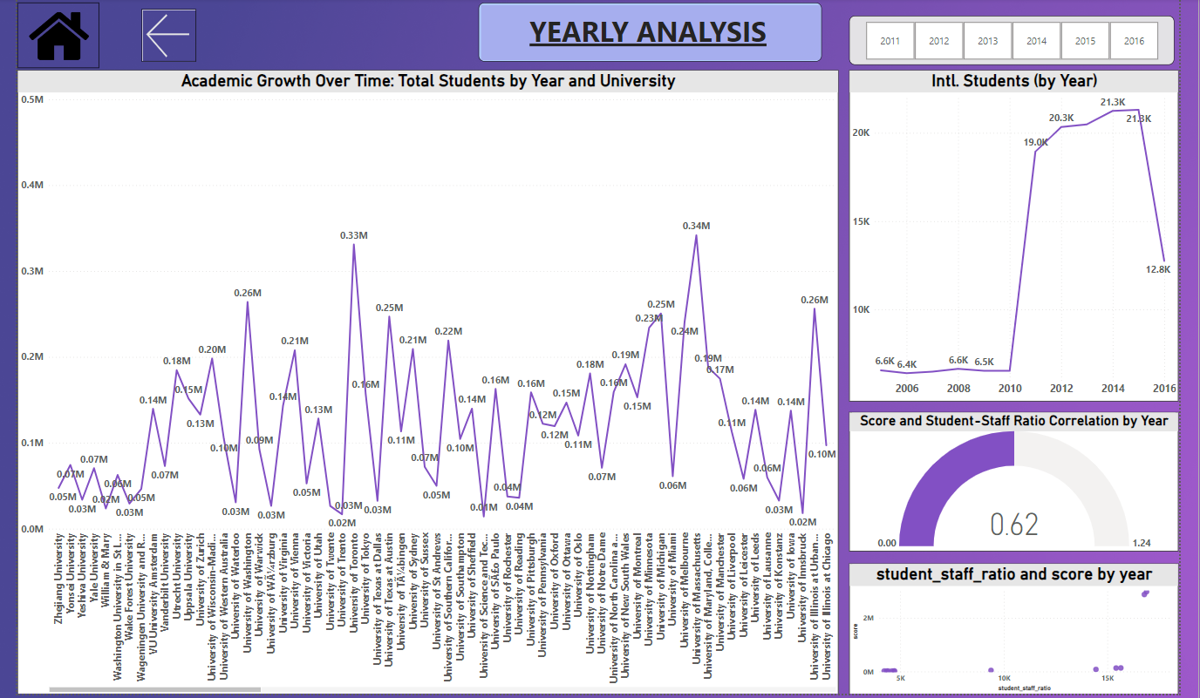

Slide 53
CONCLUSION
Taking a closer look at the university data, it's like peeking into this amazing global classroom. You can't miss how the United States plays a major role, with its universities taking center stage in the academic world. Then, when you dive into how we rank these schools, it's a bit like untangling a web of preferences and rules.
But what caught my eye was how these rankings change over time and across countries. It's a reminder that things are always shifting in education, like in life. When we connect the dots between a university's score, how many teachers they have for each student, and the mix of international students, it tells a story about what makes an institution tick.
And speaking of stories, looking at the students, there are some fascinating trends. It's not just about numbers; it's about who's in the room. This project is like holding up a mirror to our universities, showing us the need to create spaces that embrace everyone. In a nutshell, it's not just about rankings; it's about understanding and adapting to our big, interconnected world of higher education.

